Slide 1

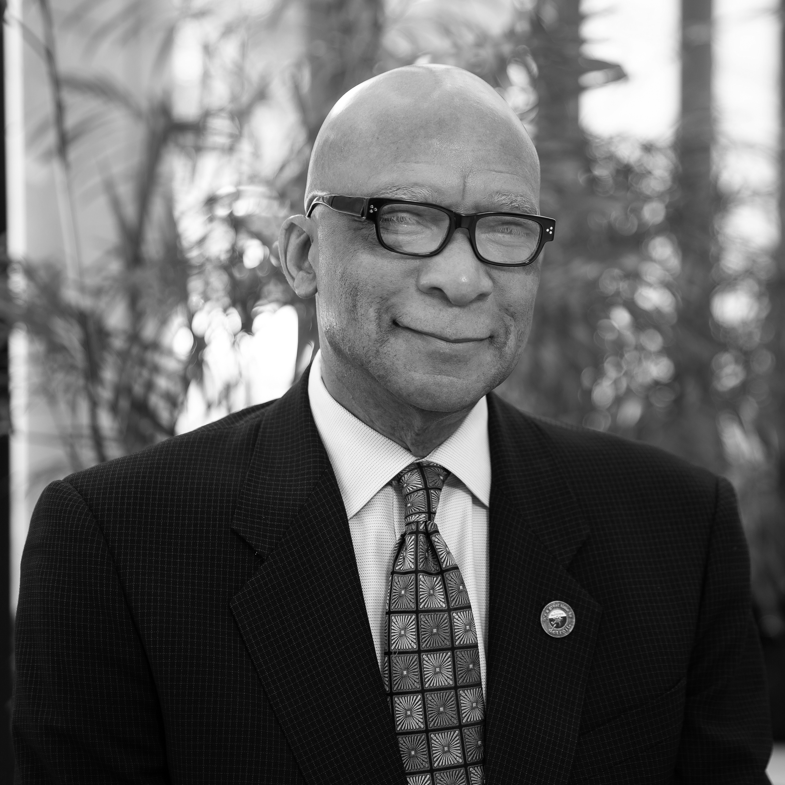
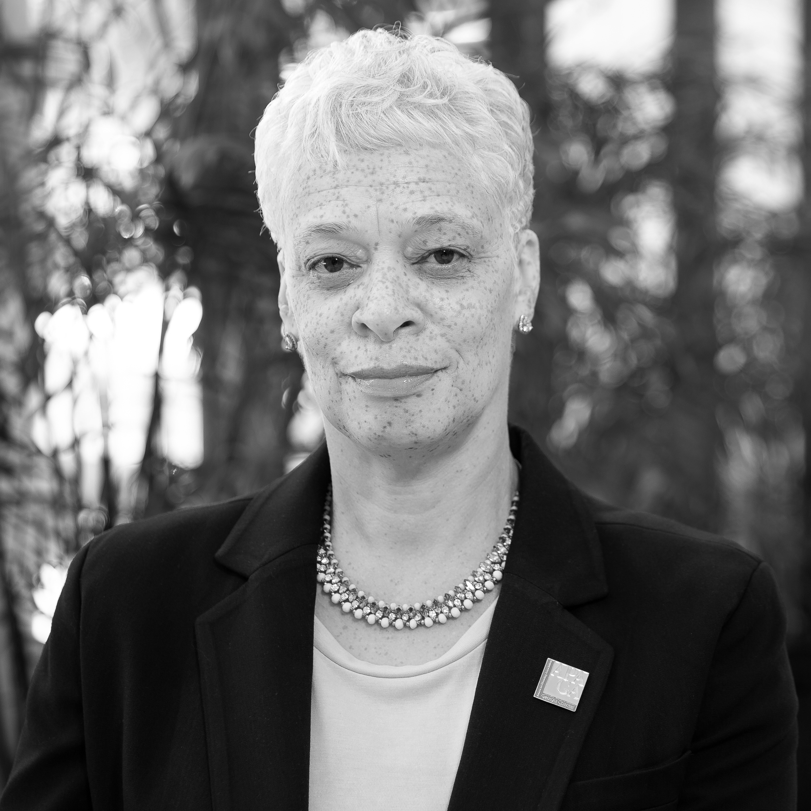

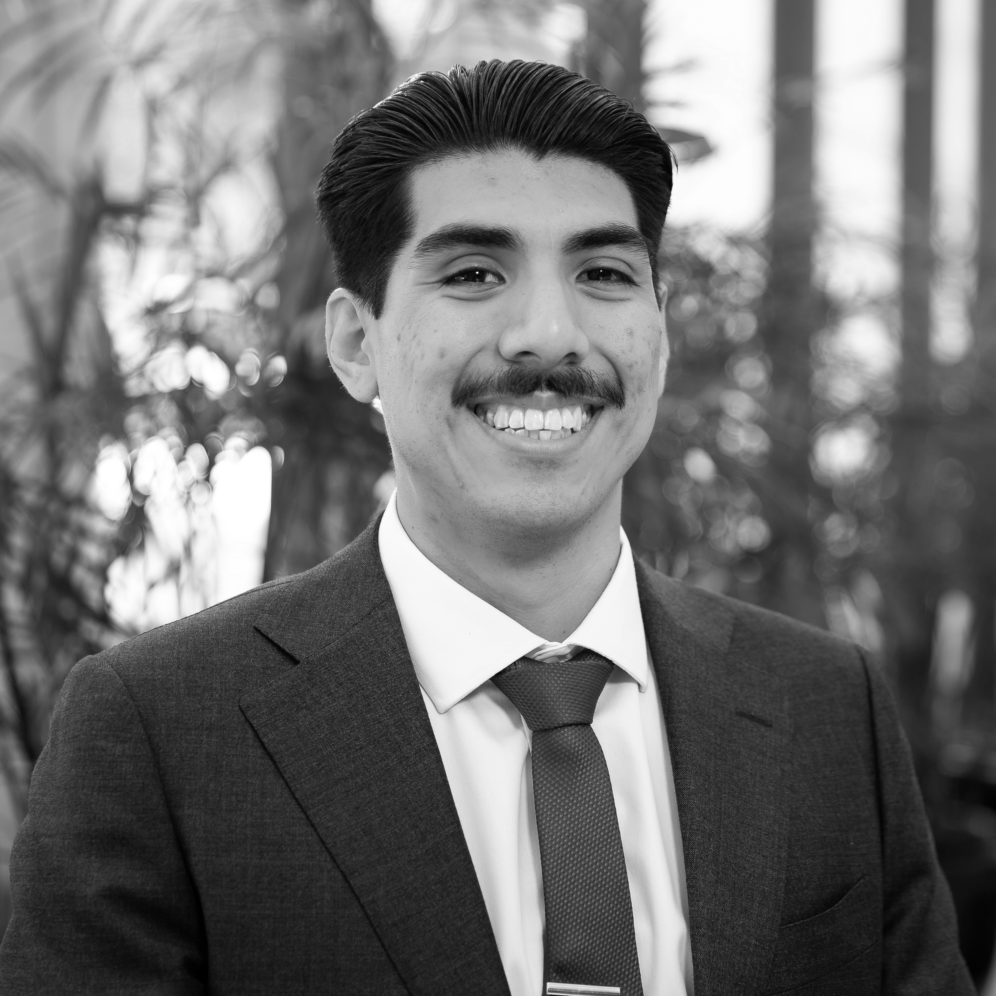
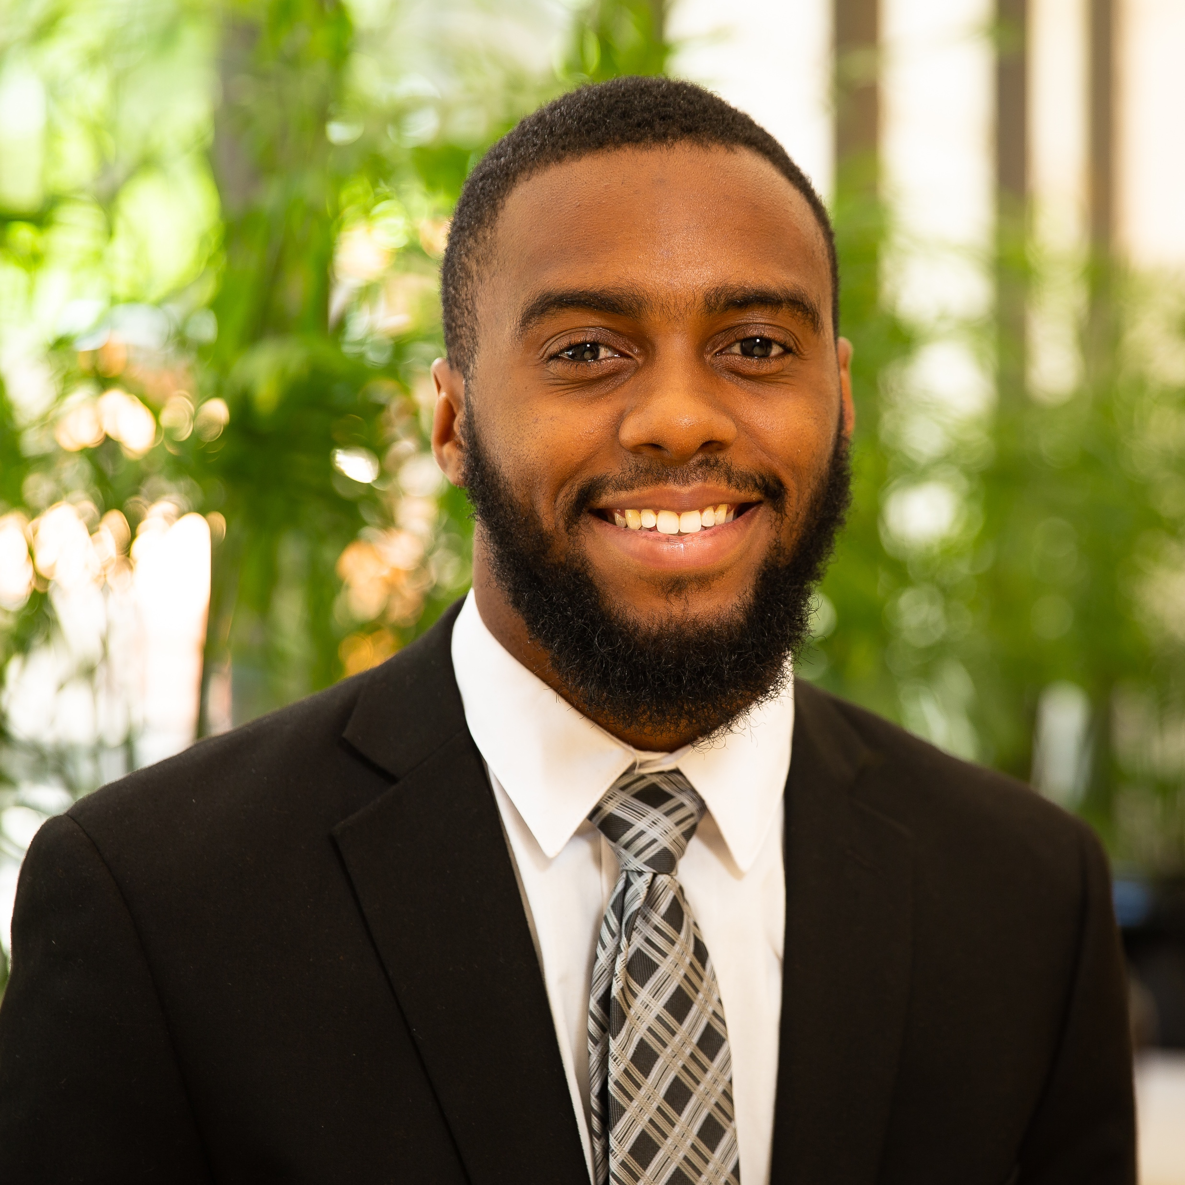

APD Urban Planning and Management
Choice neighborhoods consultant
JESSE
WILES
BRIDGET
WILES
DEBORAH
JENSEN
COO/
Project Manager
Senior Planning & Design Manager
A Minority-Owned National Urban Planning Firm
Established in 1990, with Corporate Headquarters located in downtown Atlanta, Georgia
National Expertise
Multi-disciplinary Professionals
Mission: Sustainable and Equitable Neighborhood Redevelopment in Partnership with Community
STEVEN
GONZALES
REGINALD
WHITE
CARTER
COLEMAN
Senior Analyst
GIS Technician/
Data Analyst
Real Estate
Development Associate

Slide 2
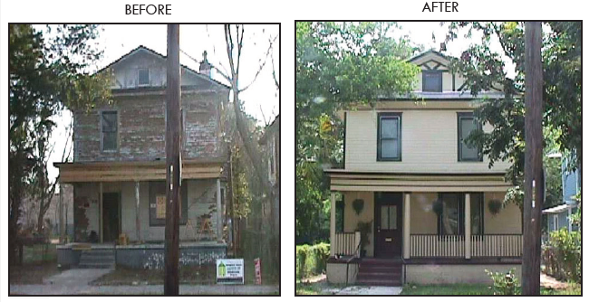
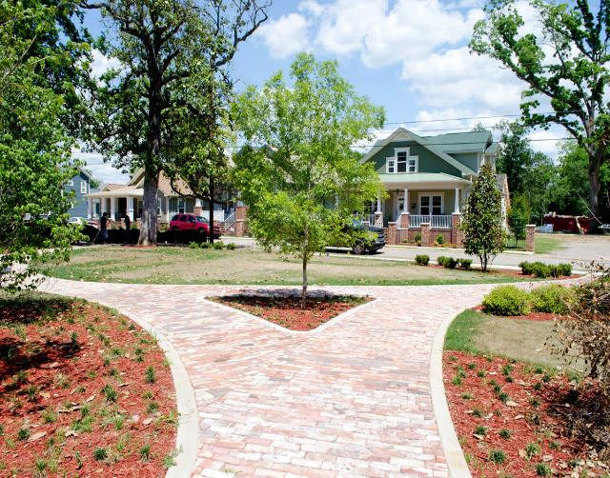
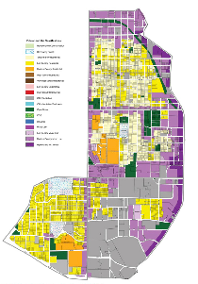
PLANNING EXPERIENCE
COMMUNITY ENGAGEMENT
COMPARABLE PROJECTS
Spartanburg, SC
Developed neighborhood Transformation Plan for the Highland community.
Augusta, GA
2013 APD-U received national HUD Secretary Opportunity Empowerment Awards for Laney Walker/Bethlehem Neighborhood Redevelopment Project.
Atlanta, GA
2017 APD-U received the Charter Award from the Congress for New Urbanism for design of the Westside Land Use Framework Plan.

Slide 3
CENTENNIAL HILL NEIGHBORHOOD
PEOPLE
HOUSING
NEIGHBORHOOD
Community Analysis

Slide 4






people
Demographic Category | Centennial Hill | Montgomery
Location Characteristics
Square miles | 0.99 | 162.3
Acres | 633 | 103,872
Population Characteristics
Total Population (2010) | 2,944 | 205,700
Total Population (2021) | 3,063 | 206,664
Total Households | 663 | 82,543
Median Age | 22.3 | 36.4
Below 18 Years of Age | 36% | 26%
Above 65 Years of Age | 16% | 16%
Average Household size | 2 | 2
White Alone | 2% | 31%
Black Alone | 97% | 61%
American Indian Alone | 0% | 0%
Asian Alone | 0% | 4%
Pacific Islander Alone | 0% | 0%
Some Other Race Alone | 0% | 2%
Two or More Races | 1% | 2%
Hispanic Origin | 1% | 4%
Income
Median Household Income | $15,658 | $51,085
Average Household Income | $32,001 | $70,582
Housing
Median Homeowner Property Value | $89,375 | $144,000
Owner | 18.9% | 50.7%
Renter | 59.8% | 36.3%
Vacancy Rate | 21.4% | 12.9%
Education and Employment
Less than 9th Grade | 6% | 4%
9th - 12th Grade, No Diploma | 10% | 9%
High School Graduate | 28% | 20%
GED/Alternative Credential | 5% | 5%
Some College, No Degree | 29% | 21%
Associate Degree | 5% | 8%
Bachelor's Degree | 8% | 20%
Graduate/Professional Degree | 8% | 15%
Centennial Hill has 10% more population below 18 years old compared to the city
97% of residents are Black compared to 61% for the city
The average household income for the neighborhood is $38,500, less than the city average
What makes the Centennial Hill community different?
65% of households in Centennial Hill live below the poverty level
There has been a slight population increase in Centennial Hill since 2000
The unemployment rate for Centennial Hill is 3% higher than the city rate
Source: ESRI Community Analyst, APD Urban Planning and Management
Notes:
Age Distribution: The neighborhood majority age group is less than 18 years of age at 36%. Seniors 65 years of age and older, comprise 16.1% of the population.

Slide 5
Employment & education
28% of Centennial Hill residents have obtained a high school degree, while 8% have received a bachelor’s degree and 8% a graduate or professional degree
69.1% of Centennial Hill residents that are employed work in the service industry
Source: ESRI Community Analyst, APD Urban Planning and Management

Slide 6
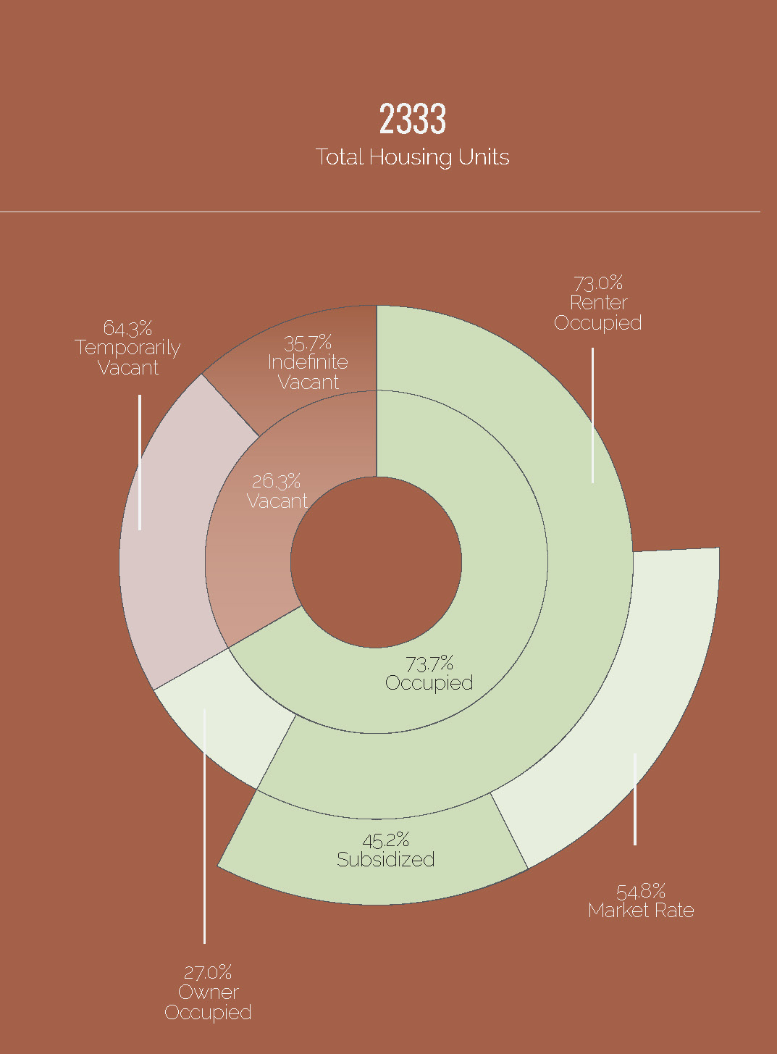
housing
housing
73% of occupied housing units are rental
46% of rental units are subsidized
The vacancy rate for Centennial Hill is 21.4%, almost twice as the city’s
Most of the occupied housing stock(76.5%) was built in 1999 or before

Slide 7
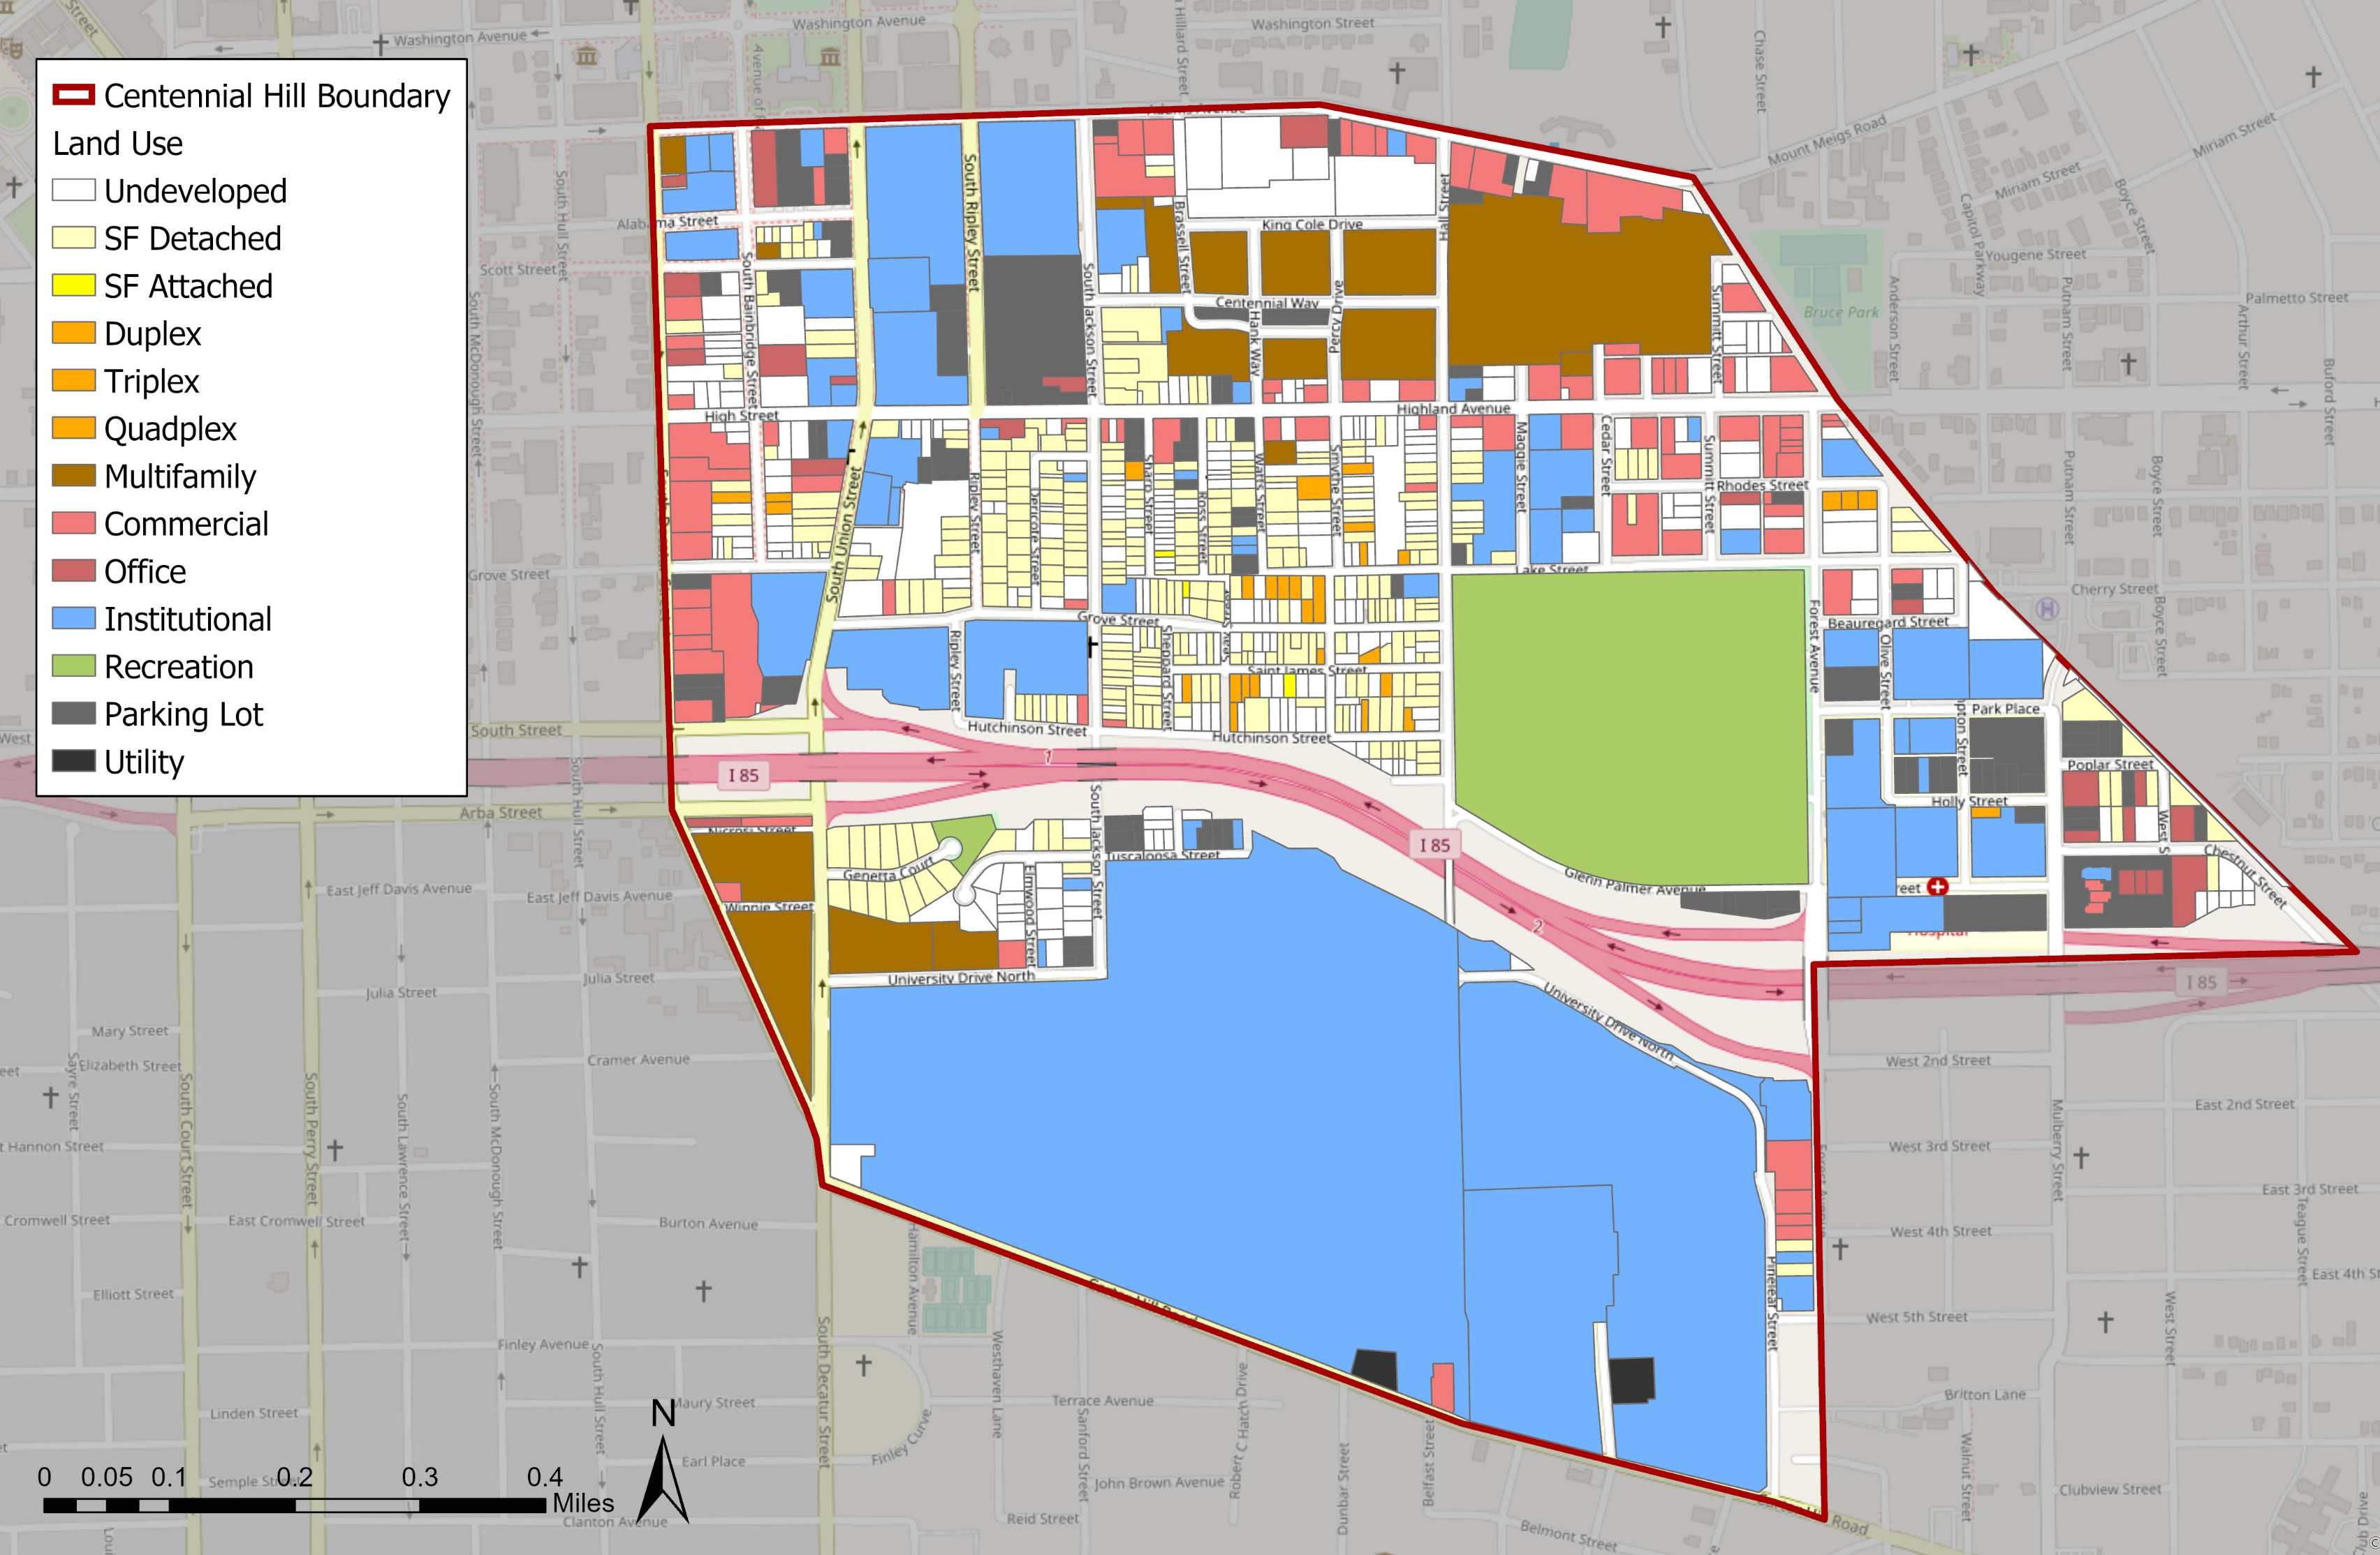
NEIGHBORHOOD: Land Use
298 parcels or 33% of Centennial Hill is undeveloped.
56.93 acres are undeveloped
85% of all housing options are single family
There are not currently any mixed-use projects

Slide 8
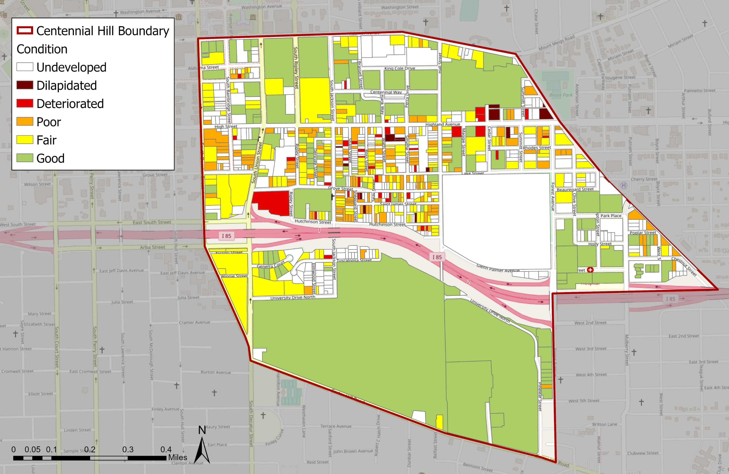
BUILDING ConditionS
Most of Centennial Hill’s buildings are in fair to poor condition
48 deteriorated or dilapidated properties
Most deteriorated properties are single family homes (24)

Slide 9
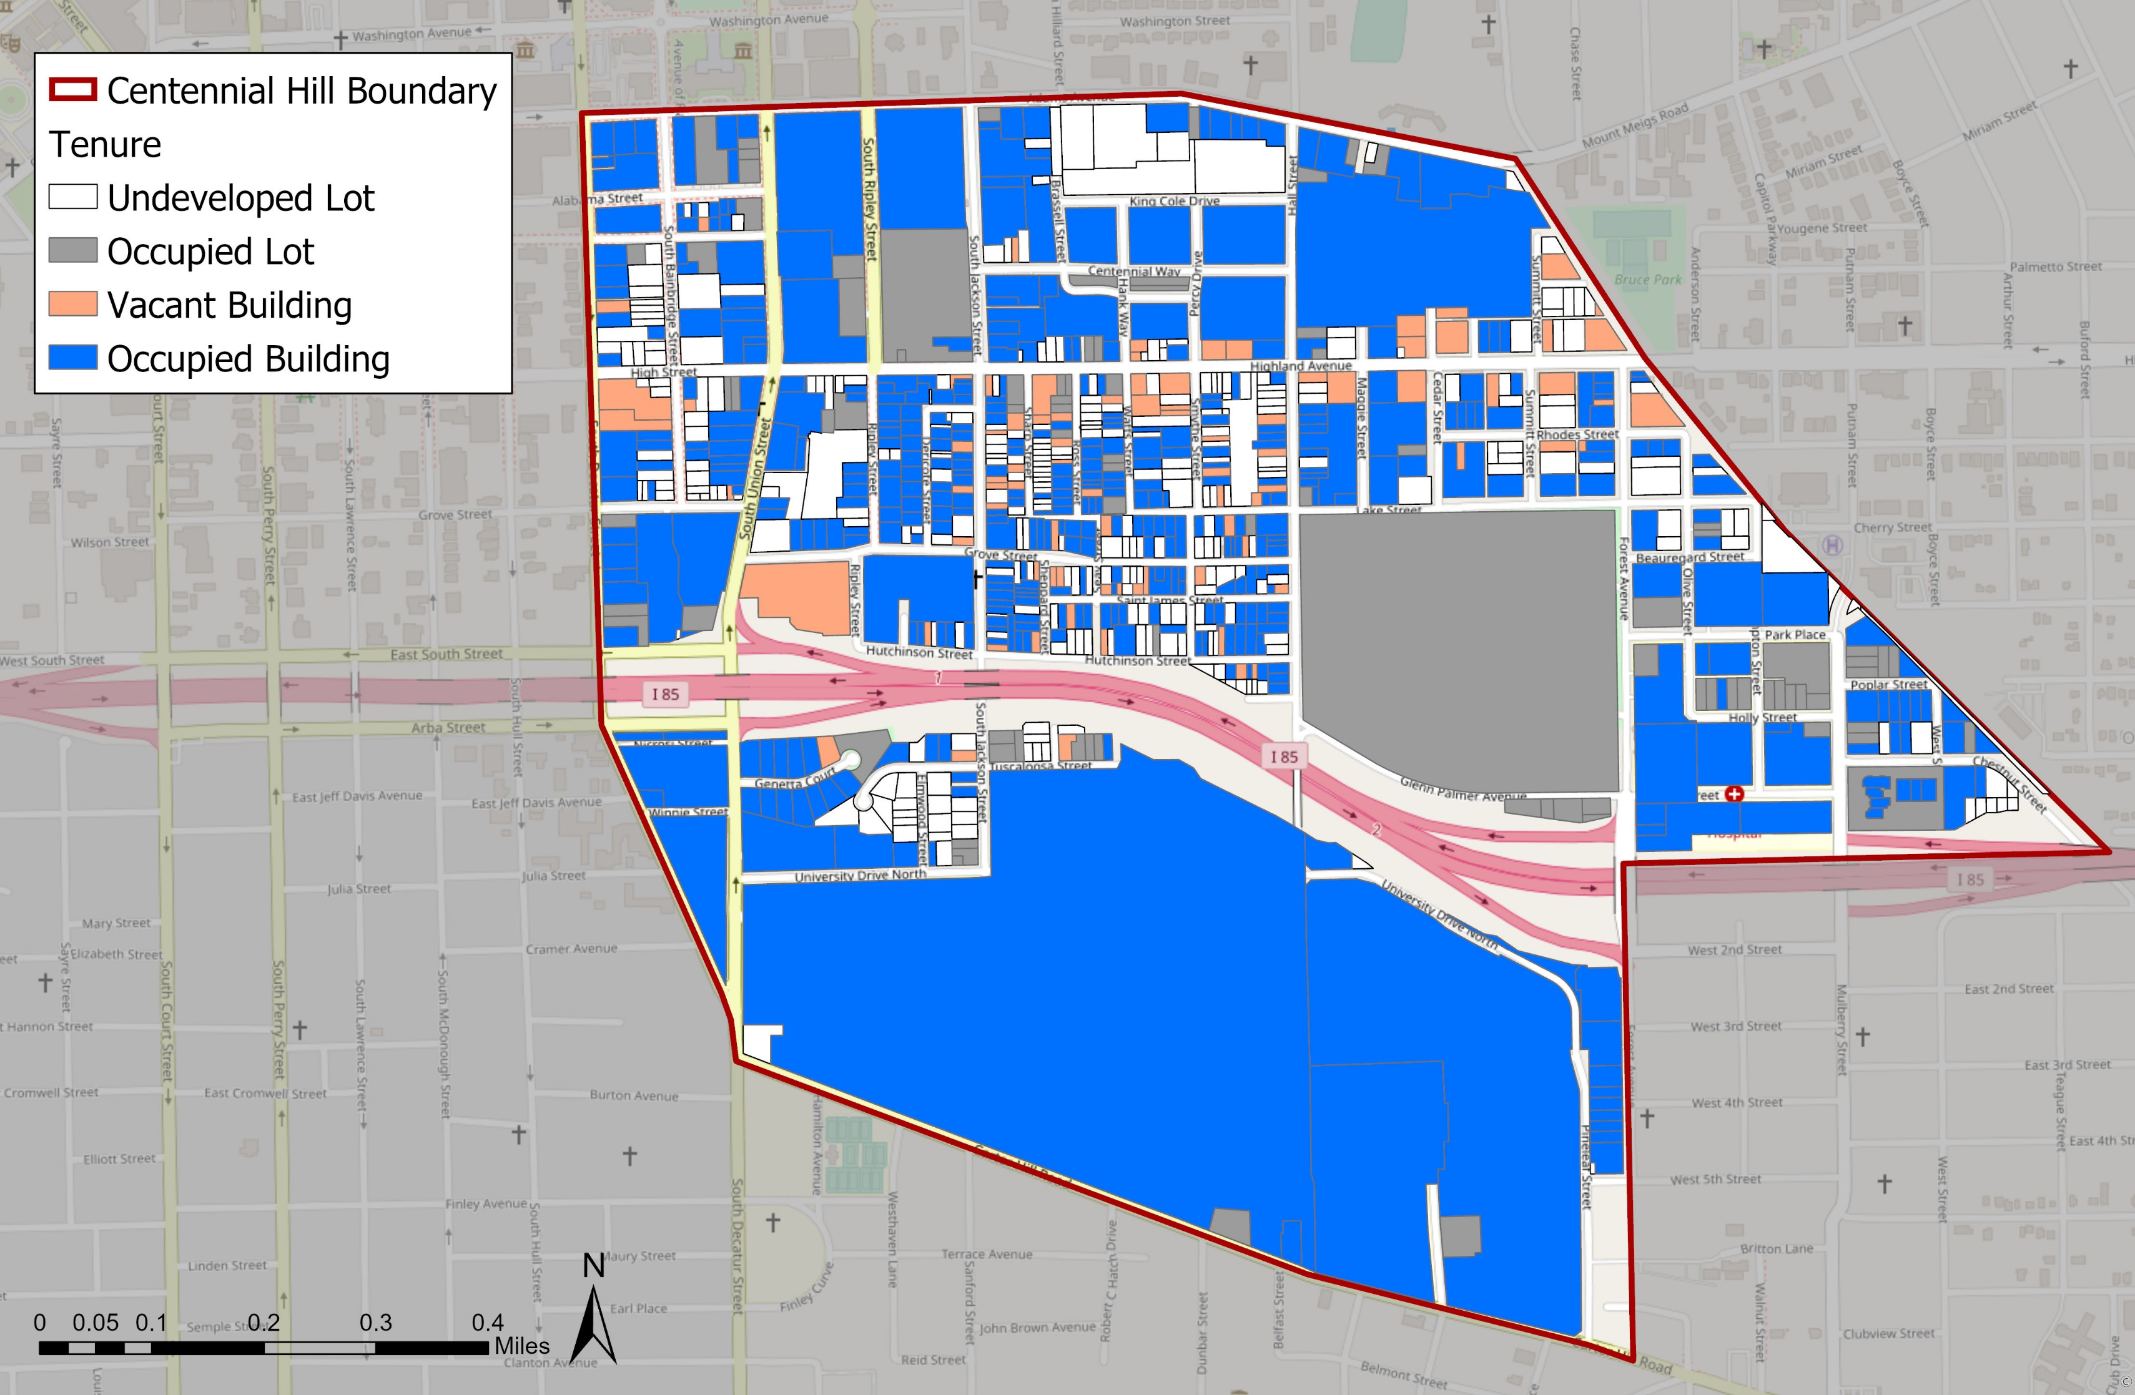
Tenure
83 vacant buildings total
45 vacant single family detached homes
25 vacant commercial building
Many occupied lots are parking which accounts for 10% of the neighborhood
  Occupied Lots (Parking Lots, Recreation lots, Utility)

Slide 10
HUD CHOICE NEIGHBORHOODS PURPOSE & INTENT
Comprehensive Neighborhood Revitalization Strategy
Revitalize distressed public housing
Catalyze critical improvements in the Centennial Hill neighborhood
  Vacant Property
  Housing – high quality, mixed-income
  Businesses – economic development
  Services
  Schools – improve outcomes
TRANSFORMATION PLAN FOR CENTENNIAL HILL NEIGHBORHOOD

Slide 11
THE ROLE OF PARTNERS
Guide Development of Transformation Plan through Participation
Make a Difference in Your Community
  Service provision
  Civil Rights history arts & culture
  Blight elimination
  Jobs training
  Work force housing
  Improved Educational Outcomes
  Economic Development
  Crime Reduction
TRANSFORMATION PLAN FOR CENTENNIAL HILL NEIGHBORHOOD

Slide 12
OUR REQUEST: PARTNERSHIP COMMITMENT FOR SUCCESS!
Data and Community Driven
  To propose partnership solutions
Alignment with Purpose and Priorities
  Partner’s organizations align with MHA/City in transforming the Centennial Hill Community
Proximity to where employees live and work
  Mixed-income, mixed-use that celebrates rich history and culture
Collaboration
  Partners/MHA/City led initiative on policy, programs, developments
Regular Communication – You are our strategic partner
Importance of your partnership to successful transformation plan and implementation grant

